Slide 1






@RLadiesMelb
WHAT'S NEW IN THE TIDYVERSE? BY PROFESSOR MINE ÇETINKAYA-RUNDEL
30 May 2023
Notes:
I celebrate and acknowledge the Traditional Owners and custodians of the land and waters from where we join you today, the Wurundjeri people of the Kulin nation. I pay my respects to their Elders, past, present and emerging and embrace their continued connection to this place. I pay my respects to all other Aboriginal and Torres Strait Islanders who may be joining us today. Sovereignty has never been ceded. It always was and always will be Aboriginal land.
We are a registered non-profit organization and a local chapter of R-Ladies Global. Our aim is to promote gender diversity in the R community, both in Australia and worldwide.

Slide 2

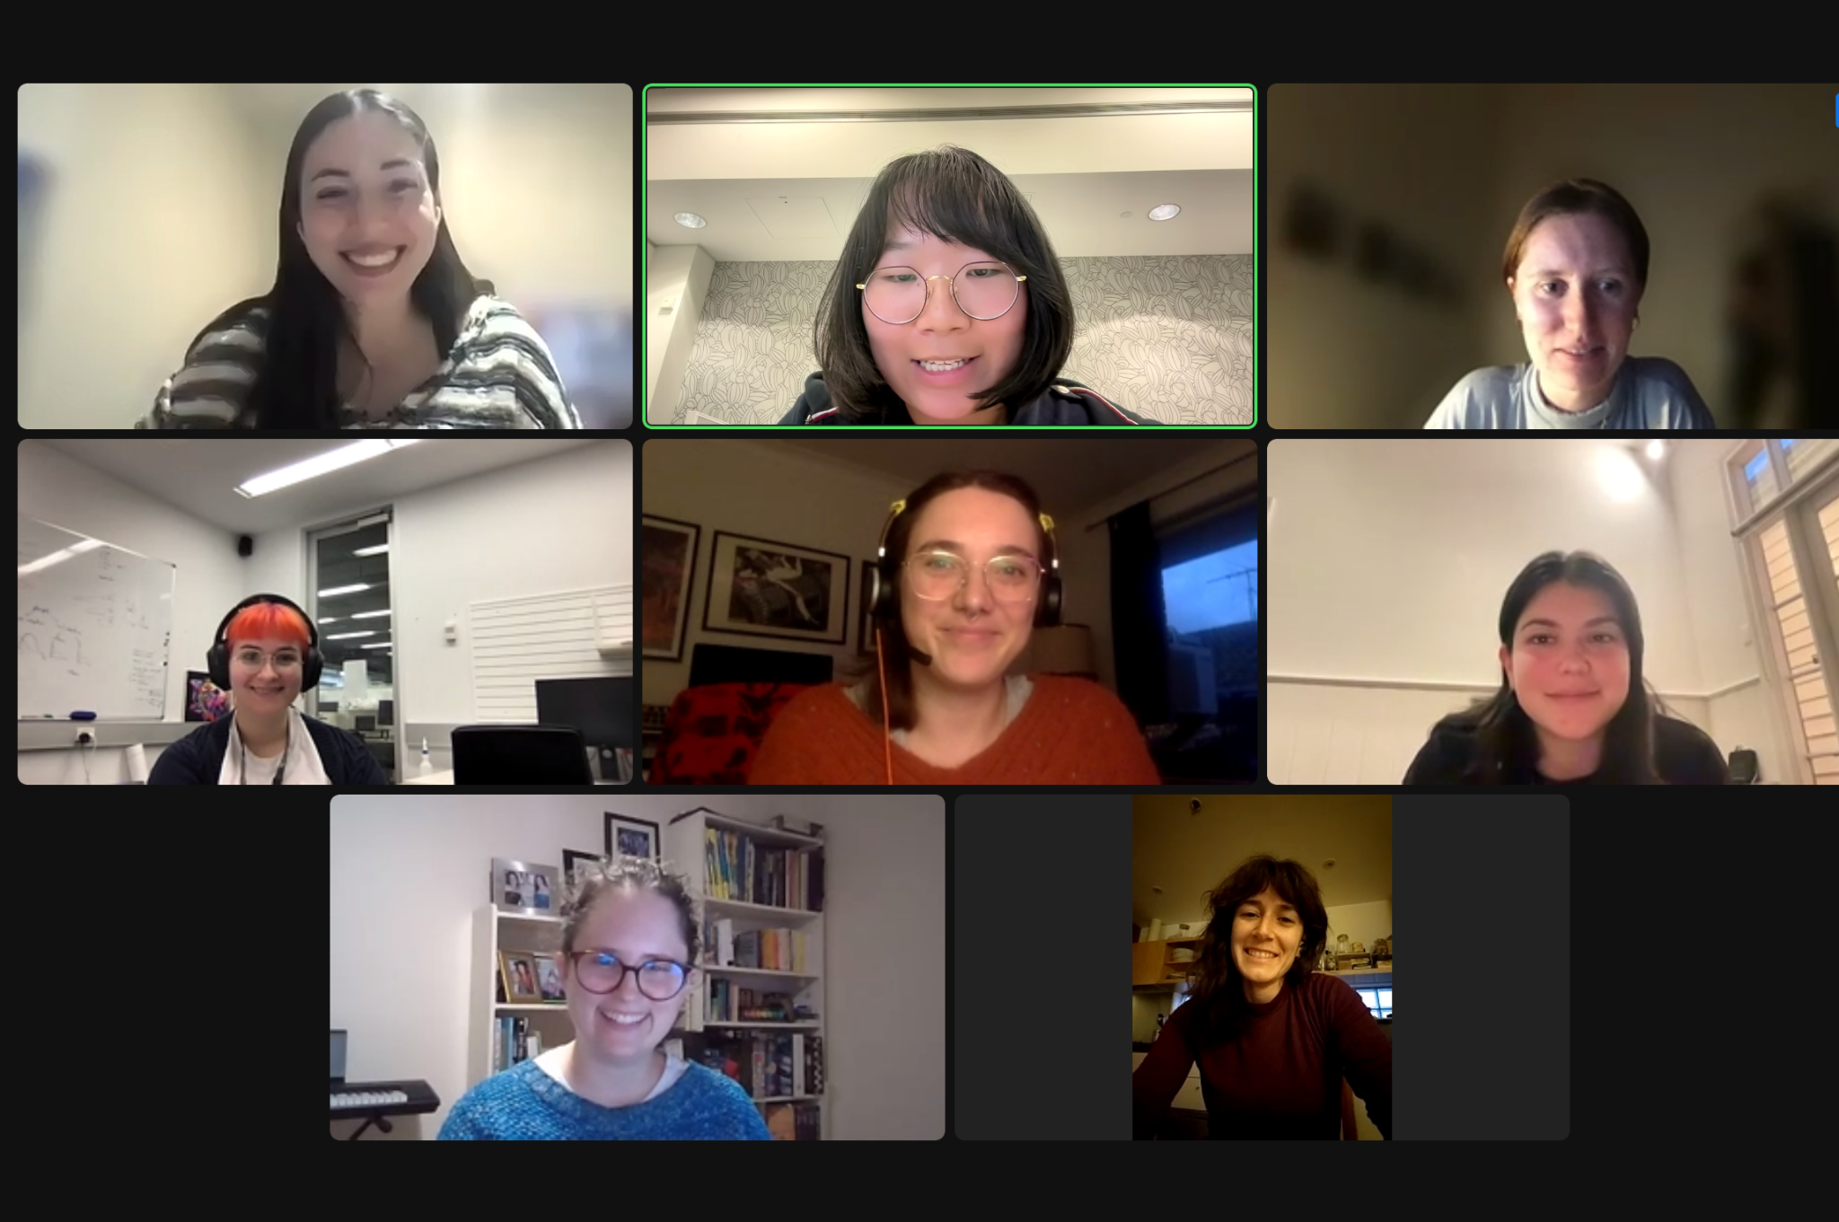
Meet R-Ladies Melbourne 2023 Committee members:
Notes:
President: Daidai
VP: Dionne
Secretary: Sehrish
Treasurer: Kathleen
Members: Anna, Caitlin, Steph. New members: Dionne and many more to come
Big thank to Evie who has led an amazing year of R-Ladies Melbourne. And thank you Nikki for taking care of finance for so many years!

Slide 3
How you can support R-Ladies Melbourne
Join our committee so you can make decisions about the future of R-Ladies Melbourne!
You must identify as a woman or other underrepresented genders as per R-Ladies Global mission
OR
Volunteer to help us with setting up successful events!
Open to everyone so you can show your support to R-Ladies Melbourne
Less commitment in terms of time, focused on events
Why?
Networking and Volunteering opportunities
Getting exposed to running public events
Getting exposed to what it means to run a not-for-profit organisation
Have fun!
Give your contribution to make the community grow and flourish

Slide 4
How you can support R-Ladies Melbourne
Join our committee so you can make decisions about the future of R-Ladies Melbourne!
You must identify as a woman or other underrepresented genders as per R-Ladies Global mission
OR
Volunteer to help us with setting up successful events!
Open to everyone so you can show your support to R-Ladies Melbourne
Less commitment in terms of time, focused on events
Get in touch:
Talk to one of us tonight!
Send us an email/message telling us how you would like to contribute:
rladiesmelbourne@gmail.com
@RLadiesMelb
Join our community slack channel for volunteering opportunities

Slide 5
Would you like to give a seminar, workshop, short talk at the R-Ladies Melbourne meetups?

Slide 6






You can find us...

